Slide 1
PEOPLE IN TECH FROM ZIMBABWE

Slide 2
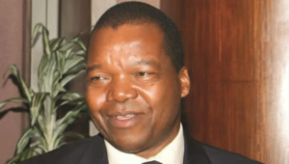
Dr.John Mangudya
Took over as Zimbabwe’s Master of Coin in 2014.
Figures out how to maintain the country’s monetary system.
Solved a biting cash crisis in 2016.
Facilitated the promotion of a “cashless society.”

Slide 3
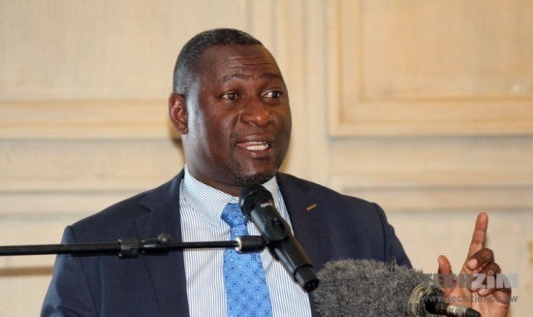
Supa Mandiwanzira
He’s the Firebrand Minister of ICT.
In 2016 he:
Championed the conclusion of the long drawn infrastructure sharing debate.
Signed off on the ICT policy after 5years of formulation.
Brought 3 draft ICT bills including a Controversial Cybersecurity Bill.
Launched a multi- million dollar slush funds for tech start-ups.

Slide 4
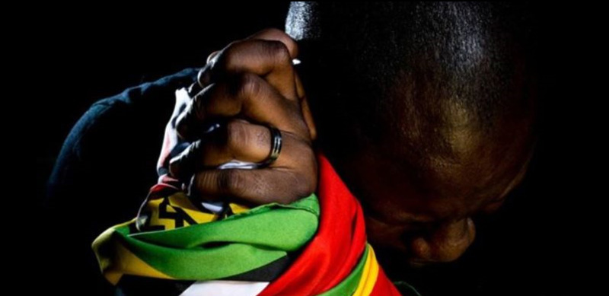
Evan Mawaire
Exiled pastor and online activist.
He harnessed social media as a tool for protest.
Started a movement called #ThisFlag .
It enhanced speedy deliberation of a cybersecurity bill.

Slide 5
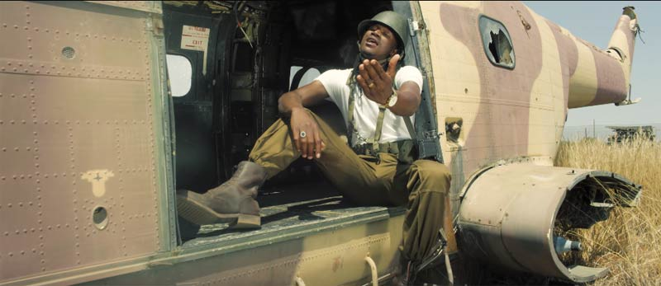
Jah Prayzah
He’s an artist with the team at JP studios.
Won major awards in 2016 like record sales.
His success majorly lies in social media.

Slide 6
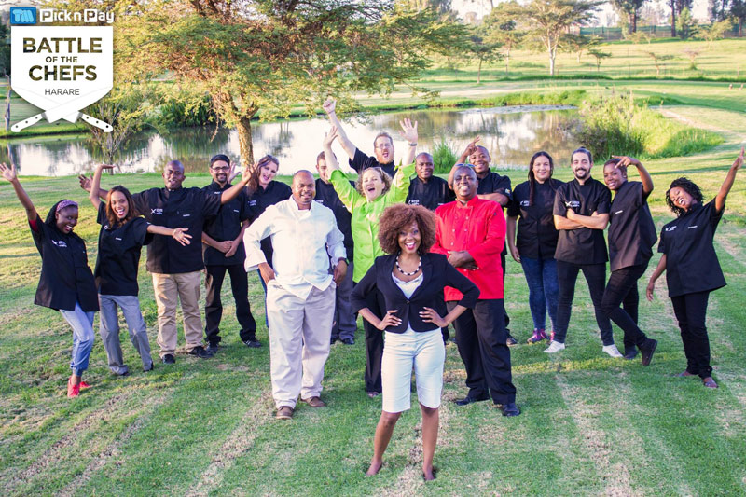
Joseph Bunga
He’s the man behind Battle of the Chefs.
Had a successful season 2.
Shows major highlight was securing a 6 figure investment.

Slide 7
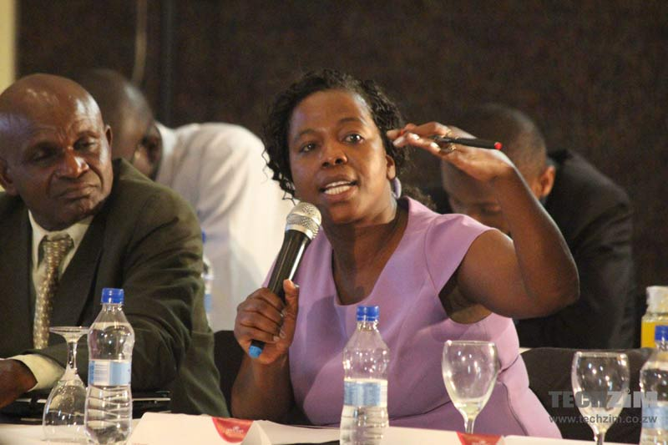
Cecilia Nyamutswa
Is the acting head of the telecoms regulator.
Was marked by the suspension of the promotions launched.
Sustained by mobile operators.
All mobile subscribers felt that.

Slide 8
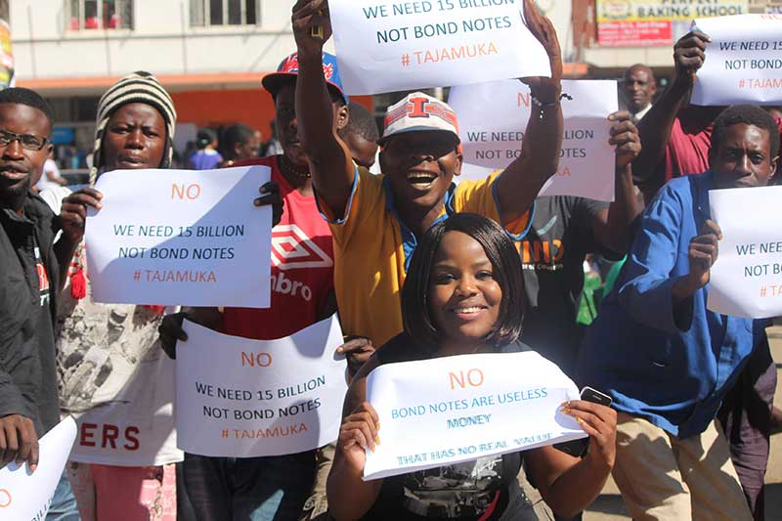
Fadzayi Mahere
She’s a vocal advocate.
Embraced social media as a platform to raise awareness on injustices.
In 2016,she took on Bond notes, banks and government ministers creating some dialogue on people issues.

Slide 9
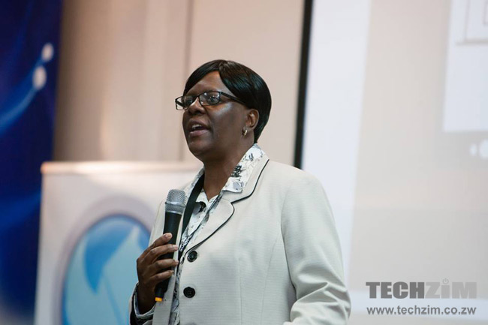
Chipo Mtasa
Is the captain of the TelOne ship.
Turned into an internet company in the past 3 years.
Embarked on an ambitious fibre project.
Fled from the unsavory image of a dead PTC.

Slide 10
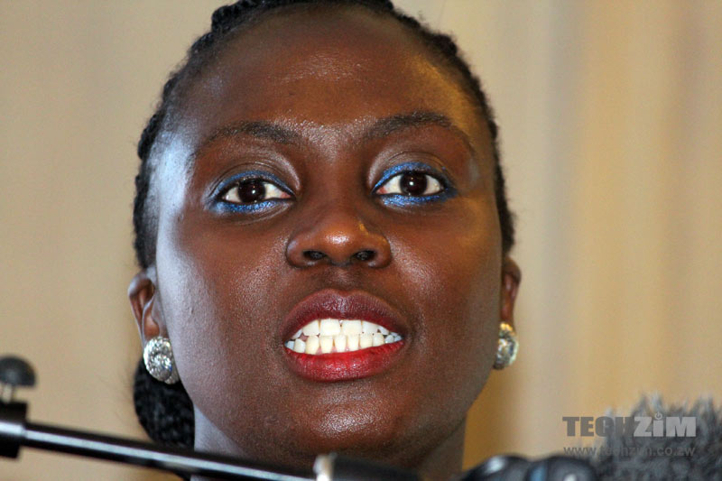
Natalie Jabangwe
She’s a celebrated fintech professional.
The biggest financial institution isn’t a bank but a mobile money service ;EcoCash.
It has earned the patronage of three-quarters of the population.

Slide 11
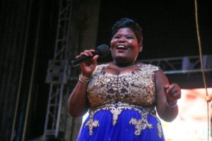
Gonyeti (Samantha Kureya)
Award winning comedian.
Is also a news anchor.
Is a role model to many.
She has inspired positive dialogue on body image issues.

